Slide 1
Finding Buffer Overﬂow Inducing Loops in Binary Executable Sanjay Rawat, Laurent Mounier Verimag Lab, University of Grenoble, Grenoble, France
Presented by:
Sanjeev kumar,
Anu Agrawal

Slide 2
INTRODUCTION
Vulnerability detection techniques, can be classified into two categories:
Static approach:
It generally consists of some code analysis without executing the application.
Dynamic approach:
It consists of executing a (monitored) instance of the application, in order to reveal some unexpected behaviour.
This paper first defines a Vulnerability patterns that if found in the application makes the application vulnerable. And then it checks the given code for that Vulnerability patterns by static analysis of binary executable.

Slide 3
WHY BINARY ANALYSIS ??
1) It is a general practice to use third-party’s libraries those
source code is not available.
2) There is significant difference between the source code
of the application and the machine code ultimately run .
3) Multi-language applications that are complied to one
common byte-code (e.g. .NETish languages).
4) Analysing the executable file increase the scope of such
analysis specially in the case of COTS softwares.

Slide 4
Vulnerability patterns
Simplest way to define a vulnerability pattern is to define it at syntactic level. e.g. presence of ‘strcpy’ family of functions in code.
However it is not the function itself, but the way this function manipulate data that makes it vulnerable. For example, strcpy function copies the source string buffer to destination string buffer without considering the length of the destination buffer.
The objective of this work is to consider more of “semantic” definition of vulnerability patterns.

Slide 5
Example vulnerable function:
Size ?
Sanity check on input ?
1 char * bufCopy ( char *Dest , char *Src )
2 {
3 char *p = Dest ;
4 while ( *Src != ’\0’ )
5 {
6 *p++ = *Src++;
7 }
8 *p = ’\0’ ;
9 return Dest ;
10 }
Loop iterations not fixed
Buffer traversal

Slide 6
BOILs and BOPs
A loop is a BOIL if :
there is a Memory Write within the loop
the written address is changing within the loop
the written value depends on a function argument
A function is Buffer-Overflow Prone (BOP) if it contains a BOIL.

Slide 7
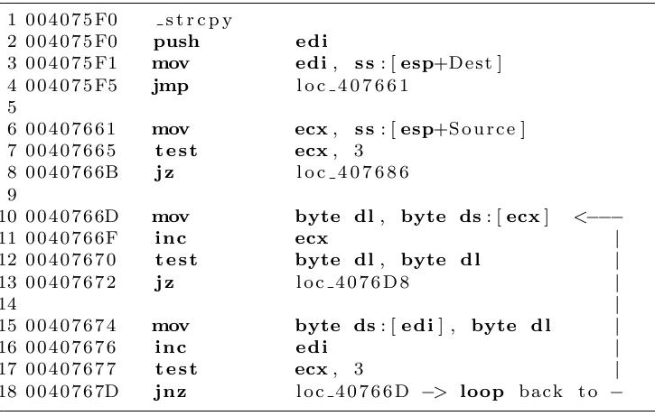
Assembly code of strcpy
Within the loop, memory is accessed via registers
Dependency on argument & local variable not visible inside the loop
Memory is written once.

Slide 8
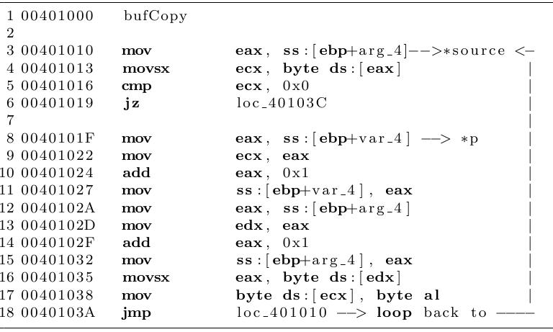
Assembly code of bufCopy
Dependency on argument/local variable visible inside the loop
Memory is written 3 times:
to change the stored address of the next character
to store the character itself

Slide 9
CODE PATTERNS
Pattern A (strcpy function):
1: regd MEM[base+dest] Destination address
2: regs MEM[base+src] Source address
loop
3: MEM[regd] MEM[regs] copy source to destination
4: regd regd+stride increment destination addr.
5: regs regs+stride increment source addr.
endloop

Slide 10
CODE PATTERNS
pattern B (bufCopy function, less straightforward):
MEM[base+p] MEM[base+dest] Destination addr.
loop
1: reg1 MEM[base+p]
2: regd reg1
3: reg1 reg1+stride
4: MEM[base+p] reg1 Next Destination addr.
5: reg2 MEM[base+src] source addr
6: regs reg2
7: reg2 reg2+stride
8: MEM[base+src] reg2 Next source addr.
9: MEM[regd] MEM[regs] copy source to Destination
endloop

Slide 11
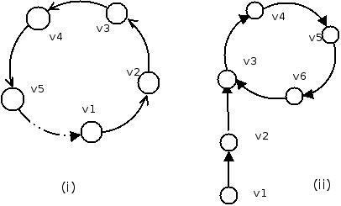
Self def-use dependency chains
Sequence of the type: v1 -> v2 -> v3 -> …-> Vk
vi = register, variable or argument ,
vi is defined in terms of vi+1 (vi := …vi+1…)

Slide 12
IMPLEMENTATION
Binary Executables
IDA PRO
Assembly Code
Bin Navi
Only 17 instructions, very simple addressing mode
Powerful jython API
CFG construction and analysis
REIL
BOIL
Suspicious Loops

Slide 13

Developing the solution in REIL
Identify memory write instructions:
In REIL, only two memory access instructions: STM (for “store memory”) and LDM (for “load memory”)
Check for the existence of extended dependency chains starting from the store addresses used by these STM statements.
Further, if we trace back the src of the instruction at 40102702 (register eax), we find that it depends on itself, with the corresponding self-dependency chain.

Slide 14
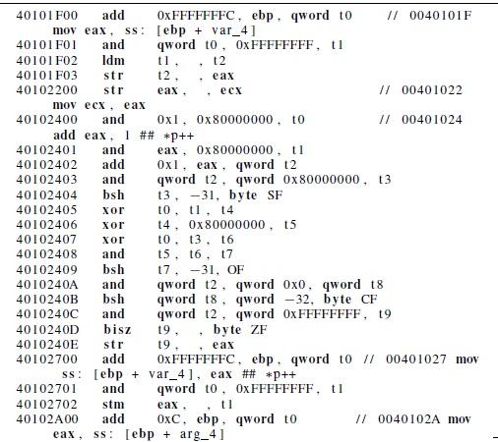

Slide 15
BOIL DETECTION
The decision procedure used for BOIL detection is :
Loop detection:
classical algorithms based on dominator tree computations.
A Memory Write inside the loop:
“store" instruction recognition
Written address is changing within the loop:
a self def-use dependency chain
Written value depends on function argument:
a def-use dependency chain

Slide 16
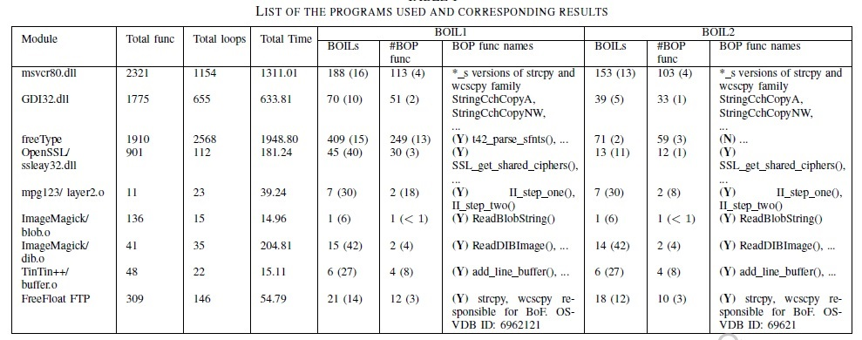
EXPERIMENTAL RESULTS

Slide 17
Conclusion
Vulnerability detection methods driven by
vulnerability patterns
These patterns needs to be:
easy to compute (scalability)
BOIL criterion was proposed for BoF vulnerabilities
Experimental results:
approx. 10% of loops are suspicious
allows to retrieve existing vulnerabilities

Slide 18
Thank You!!

